Slide 1
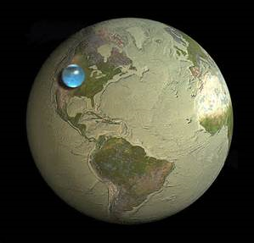
Water and Pollution

Slide 2
Water Cycle Review

Slide 3
Key Terms
Condensation: Water vapor condensing into solid (cloud)
Evaporation: Liquid water heating up and rising in the form of water vapor
“Evapo”Transpiration: Liquid evaporating from within a plant (plant sweat)
Precipitation: Condensation heavy enough to fall in the form of rain snow sleet or hail
Run Off: Water that flows from higher elevation to lower elevation
Sublimation: Solid water to gas
Ground Water: Water … in the ground :/
Infiltration: Water that “filters” into the ground

Slide 4
Water ON earth
Use this pie chart to answer the following questions:
How much fresh water is available to drink?
2. If we pollute a portion of this fresh water
that is available, how might we be affected?

Slide 5
Sources of water pollution

Slide 6
Effects of pollution on humans…

Slide 7
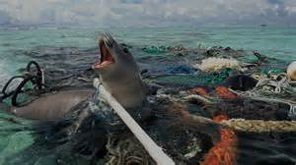
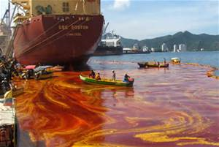
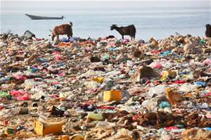
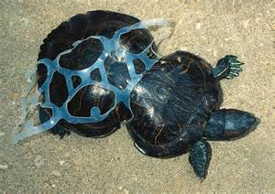
It not just humans that are suffering!!
Oil spills
Mining effects

Slide 8
How pollution spreads …
Watershed: a valley from high to low elevation that allows water to flow toward lower elevation

Slide 9
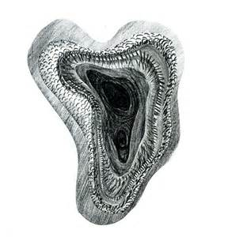
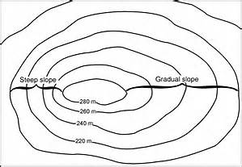
How do we study water sheds…
Topographic Map: A map tool used to indicate elevation differences in land
Counter lines: a line that connects equal points of elevation.

Slide 10
Permeability and porosity
Permeability: the rate at which liquid travels through an object
Porosity: the amount of empty space an object has that is available to hold liquid

Slide 11
Permeability

Slide 12
Porosity

Slide 13
Lets Practice…
Water Shed activity
Topographic Map Packet

Slide 14
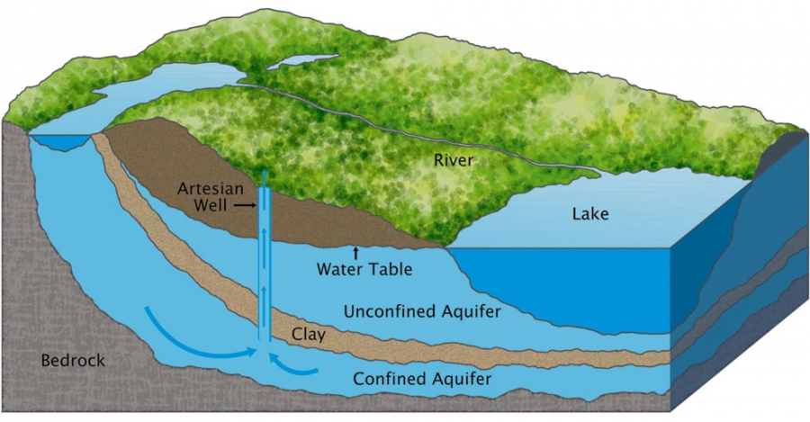
Aquifer: An underground body of water between layers of impermeable rock.
Water table: the surface elevation of the saturated water level underground.

Slide 15
Review Game

Slide 16
A water shed is…
A main body of water such as a pond, lake, stream, or river
An area of high to low elevation where water runs downward
An object used to shield water like a dam
The level of water underground that is available for drinking

Slide 17
A water shed is…
A main body of water such as a pond, lake, stream, or river
An area of high to low elevation where water runs downward
An object used to shield water like a dam
The level of water underground that is available for drinking

Slide 18
The following topographic map shows…
A peak/hill
A trench/depression

Slide 19
The following topographic map shows…
A peak/hill
A trench/depression

Slide 20
The lines that connect equal points of elevation are called…

Slide 21
The lines that connect equal points of elevation are called…
Contour lines

Slide 22
Draw and label a diagram with an aquifer and a water table

Slide 23
Draw and label a diagram with an aquifer and a water table

Slide 24
How can a topographic map be used while studying pollution?

Slide 25
How can a topographic map be used while studying pollution?
We can locate watersheds using a topographic map and then understand how water moves through and around the land. Thus, we can identify how pollution may move around the land because it travels by water! ☺

Slide 26
The amount of space that can be held between spaces in rock is called? Allowing water to flow through the spaces of rock is called?

Slide 27
The amount of space that can be held between spaces in rock is called? Allowing water to flow through the spaces of rock is called?
Porosity
Permeability

Slide 28
Quality of water can be affected by …
Water shed
Land use
Ph
Surface water

Slide 29
Quality of water can be affected by …
Water shed
Land use
Ph
Surface water

Slide 30
What percent of water is fresh water on earth? How much of that is available to drink?

Slide 31
What percent of water is fresh water on earth? How much of that is available to drink?
2.8% and only 1% is available to drink

Slide 32
If a soil sample has high porosity it most likely has ____________ permeability.

Slide 33
If a soil sample has high porosity it most likely has ____________ permeability.
High

Slide 34
Which of the following is considered the large water shed outlet for Columbus ohio?
Lake eerie
Scioto river
Pacific Ocean
Lake Michigan

Slide 35
Which of the following is considered the large water shed outlet for Columbus ohio?
Lake erie
Scioto river
Pacific Ocean
Lake Michigan

Slide 36
Rain can cause water pollution when…

Slide 37
Rain can cause water pollution when…
It grabs air pollution from the sky and forms acid rain

Slide 38
List the following in order of highest to lowest Permeability
Rock
Silt
Clay
Sand

Slide 39
List the following in order of highest to lowest Permeability
Rock, Sand, Silt, Clay

Slide 40
Impermeable means….?

Slide 41
Impermeable means….?
Water/liquid cannot flow through.

